Slide 1
Model design
We are using tools from statistical physics to develop computational model of the cancer progression process. We will be using basic statistical physics to develop the cellular Potts model of the starting phase of cancer development. The mathematical model will be developed using already available software package (CompuCell3D).

Slide 2
Cell mitosis/division
Mitosis/Cell division has been incorporated in a detailed manner in the computer model generated. Every single cell has a unique copy of its critical parameters, which are checked after every MCS, and cells are divided whenever they satisfy the criteria as listed below –
Size dependent cell division - Every cell has a unique dividing volume as a parameter for itself. As a cell grows with age, whenever it crosses this threshold ,it is made to undergo mitosis.
2. Age dependent cell division - Due to the growth of cell mass in a confined space, after some time, enough volume is not available for cells, due to which they age without much increase in volume. This criteria cares for the adaptation of a cell in reducing its dividing volume, to a point such that after a certain age, the cell can undergo mitosis even if it does notreach its original division volume.

Slide 3
Cell death
Cell death has been incorporated in the model in the following two manners –
Age dependent cell death - Along with the rapid growth of cells in population, 10% of the total cells are randomly selected based on uniform distribution, after every 10 MCS ( this can be replaced with actual time), and put to death.
2. Stress dependent cell death - Due to the growth of cell mass in a conned space, after some time, stress developed inside a cell becomes critically high and unfeasible for its existence. The stress developed is calculated as the ratio of the cell's target volume to its volume , and any cell for which it exceeds 5, is put to death.

Slide 4
Model implementation
Based on the above parameters, CompuCell3D was used to create a CC3D model of cell growth. The model was constructed mainly in python, but involved XML as an integral part too. The simulations were run on CompuCell3D using this model, and a CSV file containing the parameters stated above, for each cell at every MCS, was generated. For statistical analysis, Canopy, a special Python distribution by Enthought, having packages such as NumPy, Pandas and SciPy pre-installed, was used. The IPython or Jupyter Notebook was used for all the statistical analysis, and MATPLOTLIB was used for plotting the data.

Slide 5
Model Parameters
1. Lattice size - 200x200
2. Geometries – Square, Triangle, Circle
3. Cell Volume - 25
4. Cell Division Time - 50 MCS
5. MCS – 3500

Slide 6
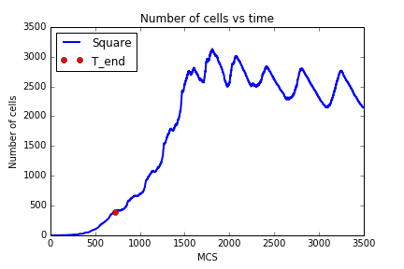
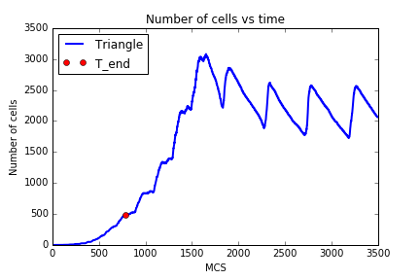
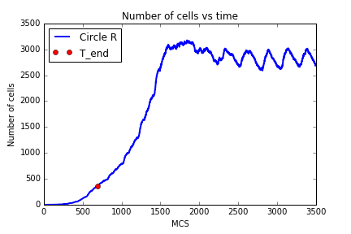
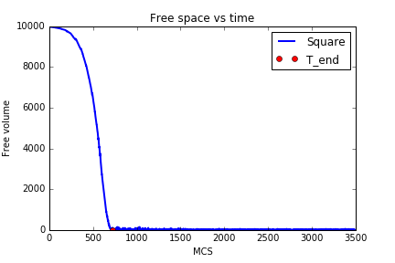
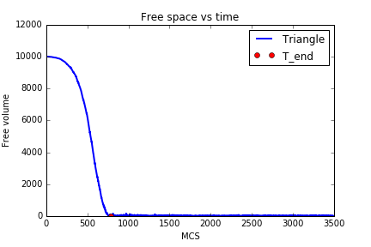
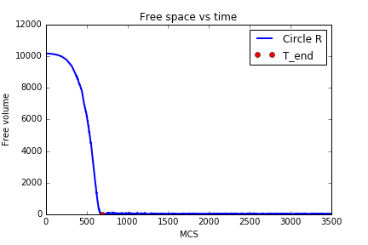
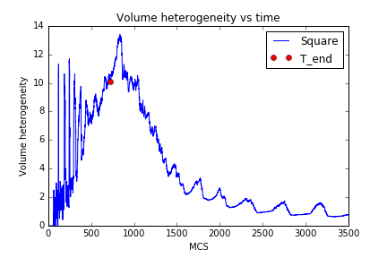
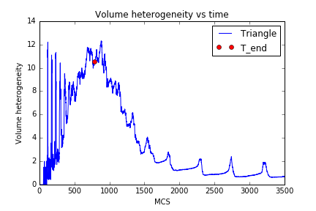
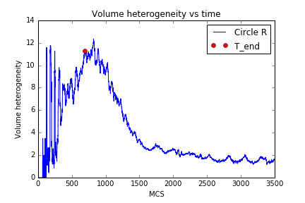
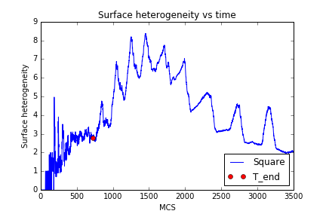
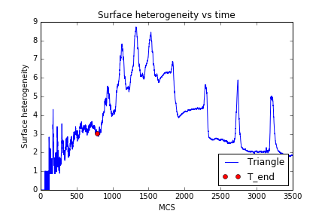
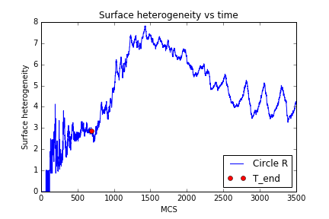
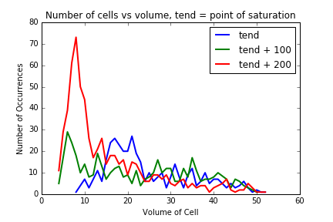
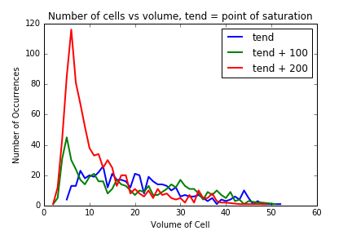
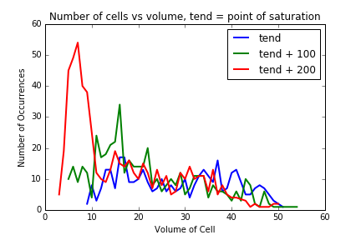
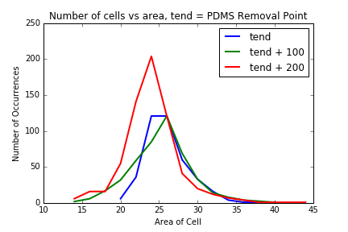
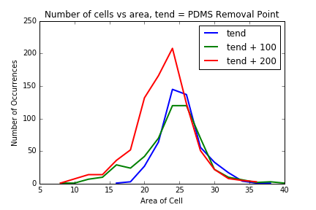
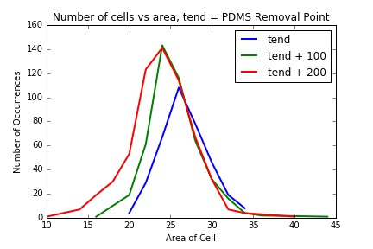
SA Dist Vol Dist SH VH Free Space Cell Count

Slide 7
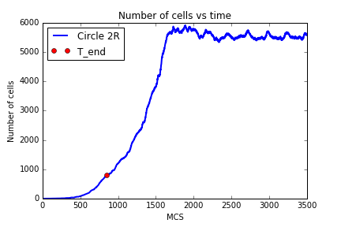
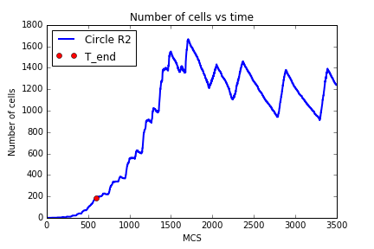
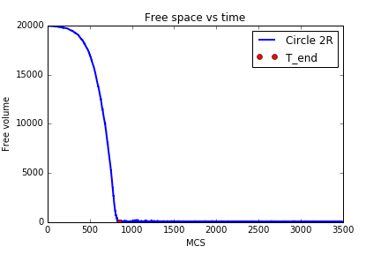
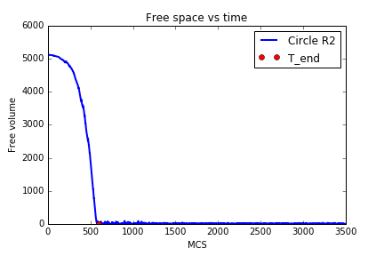
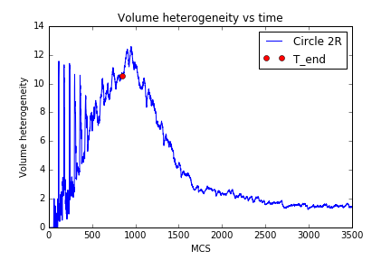
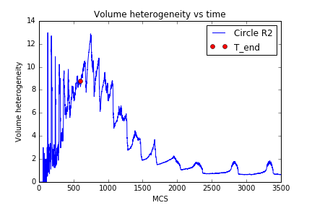
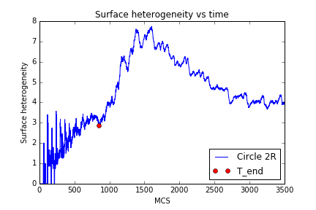
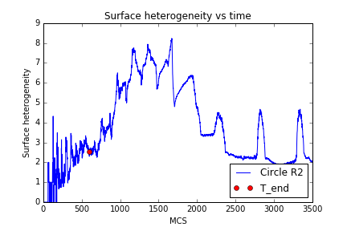
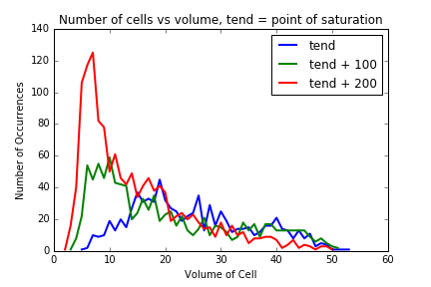
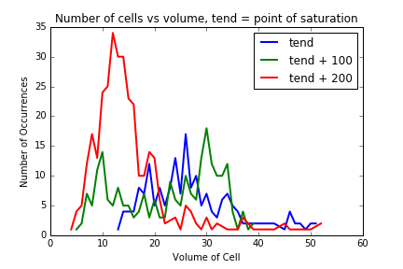
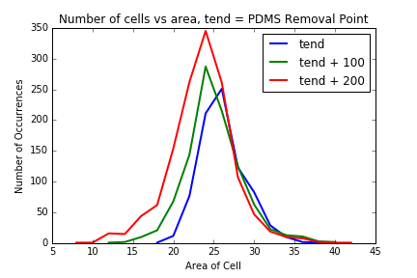
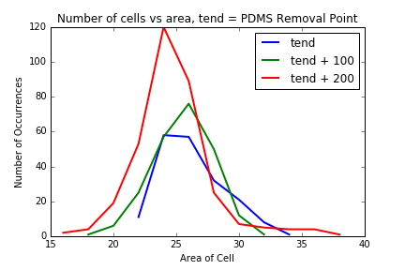
SA Dist Vol Dist SH VH Free Space Cell Count

Slide 8
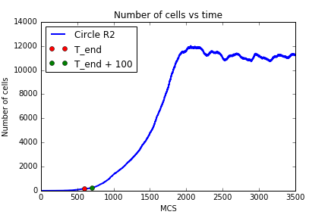
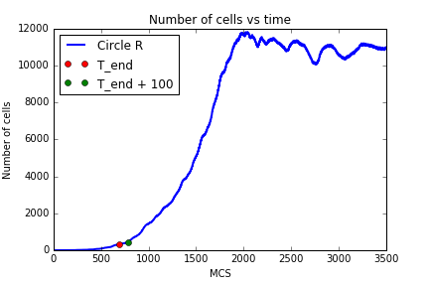
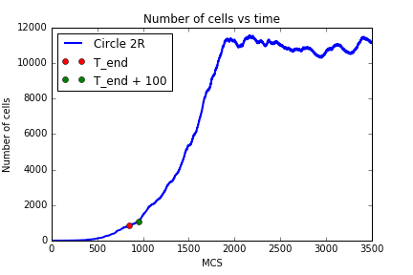
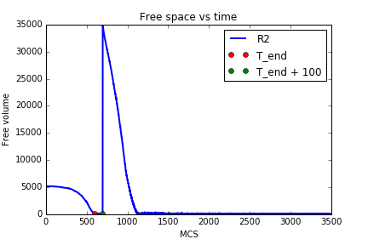
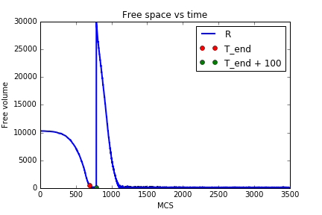
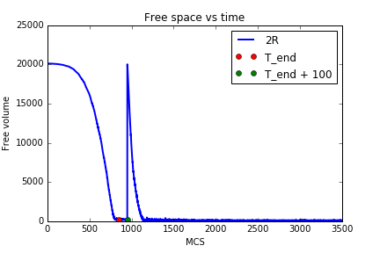
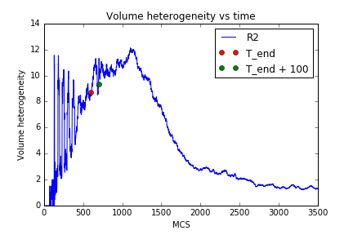
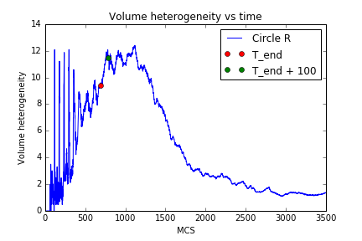
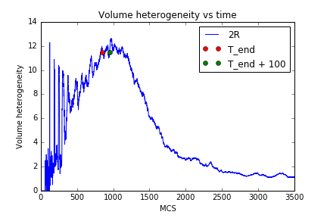
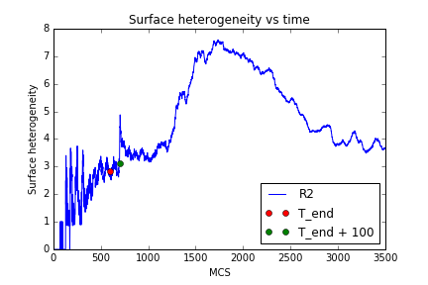
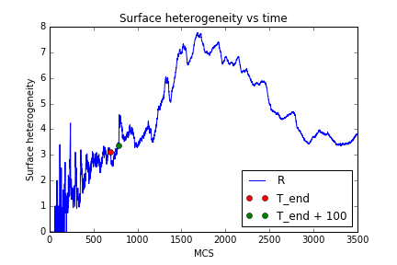
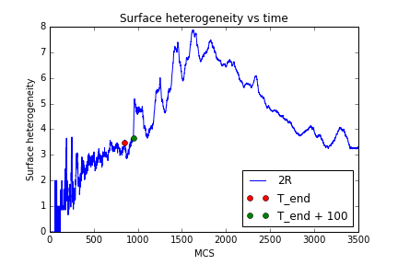
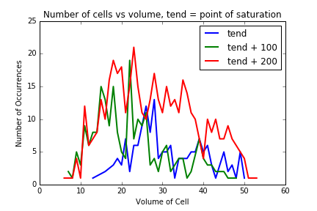
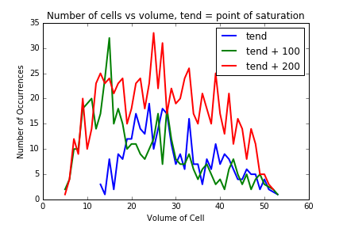
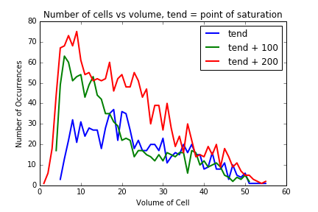
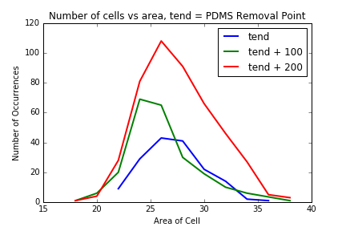
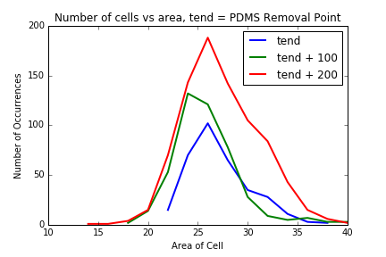
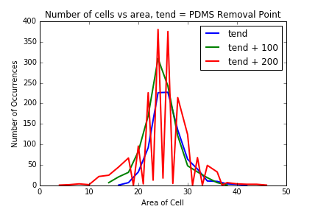
T end = 596
T end = 687
T end = 849
SA Dist Vol Dist SH VH Free Space Cell Count

Slide 9
Jcc = 5

Slide 10
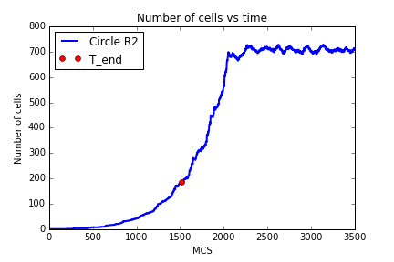
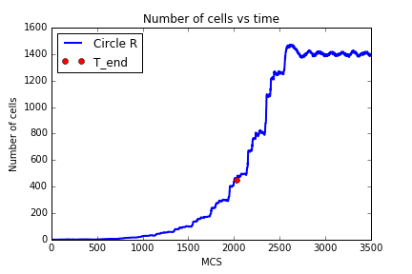
















SA Dist Vol Dist SH VH Free Space Cell Count

Slide 11












Circular VH Cell Tend+200 Cell Tend+100 Cell Tend

Slide 12









Volume Tend+200 Volume Tend+100 Volume Tend

Slide 13
Jcc = 10

Slide 14


















SA Dist Vol Dist SH VH Free Space Cell Count

Slide 15












Circular VH Cell Tend+200 Cell Tend+100 Cell Tend

Slide 16









Volume Tend+200 Volume Tend+100 Volume Tend

Slide 17
Jcc = 20

Slide 18


















SA Dist Vol Dist SH VH Free Space Cell Count

Slide 19












Circular VH Cell Tend+200 Cell Tend+100 Cell Tend

Slide 20









Volume Tend+200 Volume Tend+100 Volume Tend

